Slide 1
Connecting Ammeters and Voltmeters in a Circuit

Slide 2
Connecting the Voltmeter
Voltmeters are connected in parallel.
  This means that they are connected across the device.
V
R₁
A voltmeter is a peripheral device that does not affect the operation of the circuit itself.
V
+
R₂
V
R₃
V

Slide 3
Connecting the ammeter
While voltmeters are connected in parallel, Ammeters are connecting in series.
  This means that they are an integral part of the circuit.
  Current has to flow through them in order for them to take a measurement.
R₁
A
V
+
R₂
A
R₃
Remember:
I
Am
Serious
Current
Ammeter
Connect in Series

Slide 4
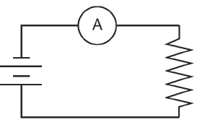
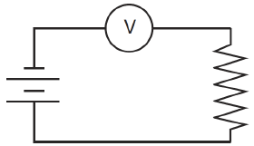
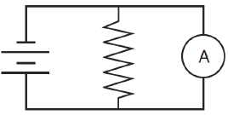
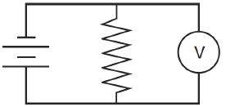
Example:
Which one(s) is (are) correct?
1
2
3
4
Ammeters in series (1), and Voltmeters in parallel (4)

Slide 5
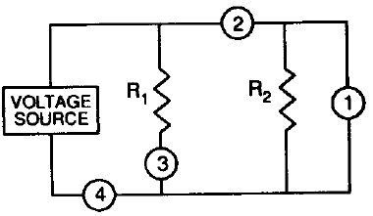
Example
Where to place the meter
What type of circuit is it?
Where would you put a meter in the circuit to measure the total current?
Where would you put a meter in the circuit to measure the current through R₁?
Where would you put a meter in the circuit to measure the current through R₂?
Where would you put a meter in the circuit to measure the total voltage?
Parallel
4
3
2
1
A₂
V
A₁
A_{T}

Slide 6
What does happen when a meter is connected incorrectly
What happens if an ammeter is connected in parallel?
  You get a short circuit. Why?
  Because ammeters have virtually no resistance.
REMEMBER: ELECTRICITY ALWAYS TAKES THE PATH OF LEAST RESISTANCE
What happens if a voltmeter is connected in series?
  The circuit will not operate. No current will flow. Why?
  Because voltmeters have virtually infinite resistance.

Slide 7
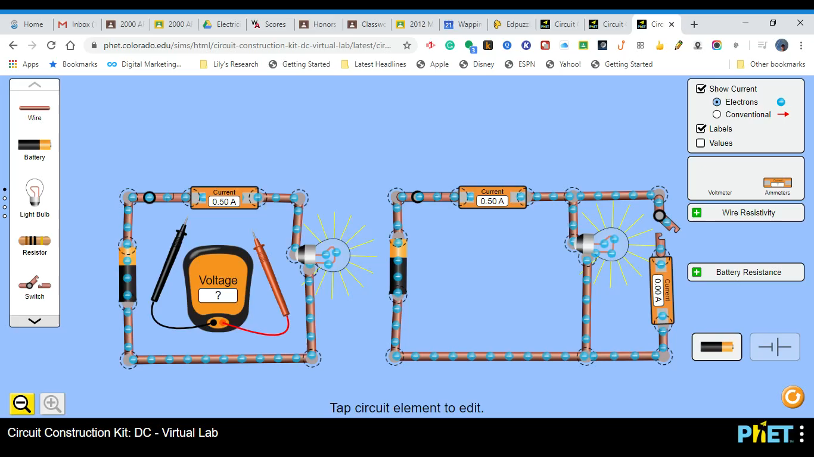
PHET Simulation

